Slide 1


Slide 2
Agenda
Who am I?
What is AI, ML and DL?
What are Perceptrons?
The Perceptron ‘class’ – no libraries!
Single node point and line
Single node point and line with bias
Single node logical gates: AND, OR
Multi-node logical gate: XOR
Multi-node point and parabola

Slide 3






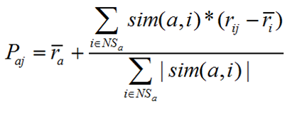
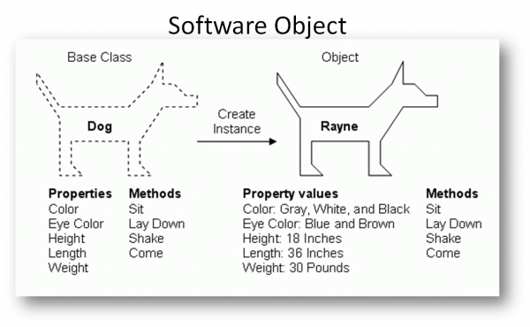


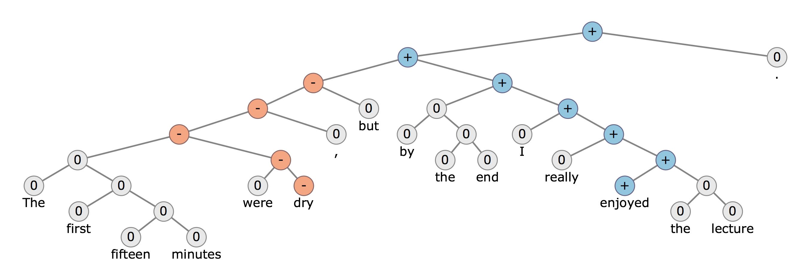

Slide 4


Slide 5



Slide 6


Slide 7


“A computer program is said to learn from experience E with respect to some class of tasks T and performance measure P if its performance at tasks in T, as measured by P, improves with experience E.” – Tom Mitchell

Slide 8


Slide 9


Slide 10
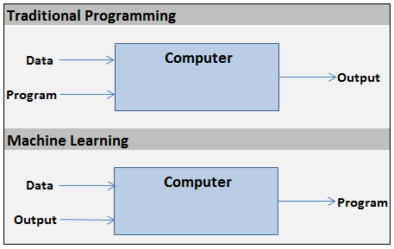

Slide 11

source: Andrej Karpathy, Train AI 2018 Conference

Slide 12







Slide 13


x₀
Summation/
Hypothesis
Forward propagation
w₀
Activation (i.e. step)
x₁
w₁
x₂
w₂
output
x₃
w₃
Σ
y
inputs
w₄
x₄
.
.
.
w_{n}
h(X) = x₀w₀ + x₁w₁ + … + x_{n}w_{n}
x_{n}
1, if h(X) >= 0
y =
weights
0, if h(X) < 0

Slide 14
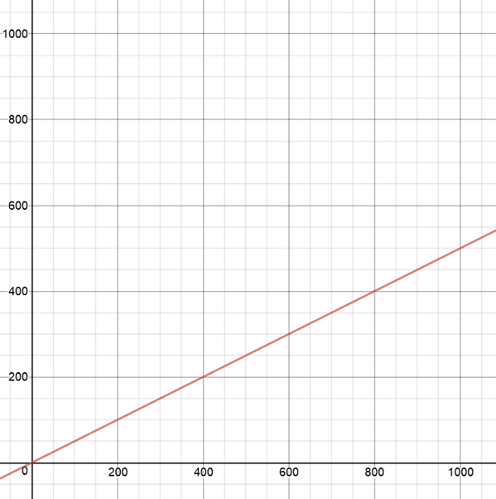

Supervised learning
Classification
(liner)
point to test
2nd input –
y-coordinate
y = 0.5 * x
1st input –
x-coordinate

Slide 15
x-coordinate
x₀
w₀
output
Σ
y
inputs
w₁
x₁
weights
y-coordinate

Slide 16
learning rate – small number
(i.e. 0.01)
Backward propagation
x-coordinate
w₀ = w₀ – error * x₀ * α
x₀
w₀
error =
Σ
y - ŷ
Inputs
w₁
actual
value
guess
x₁
w₁ = w₁ – error * x₁ * α
Hyperparameter
y-coordinate

Slide 17
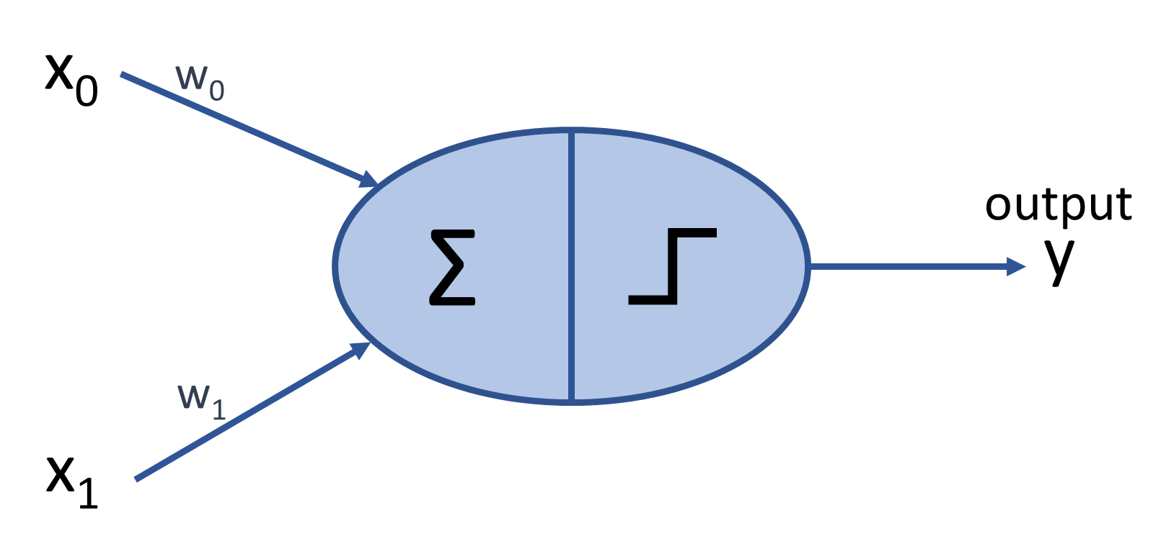
After 1000 training points:
w₀ = -18.29
w₁ = +36.82
-18.29x + 36.82y = 0
y = (18.29/36.82)x
y = 0.4969x
accuracy 99.9%
y = 0.5x
Notes:
Bonus task: try to see how the learning rate affects the ‘speed’ with which the model converges. What’s the largest learning rate that can be used while still enabling the model to converge. How does this affect the minimum number of training points required?

Slide 18
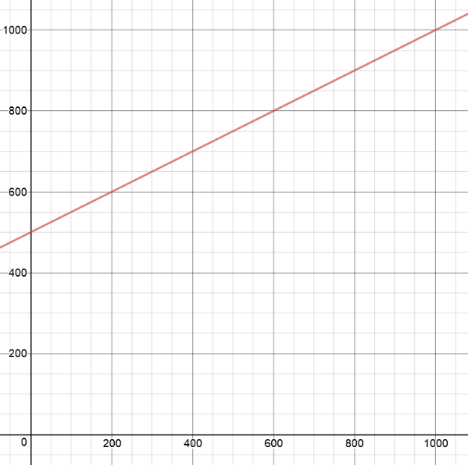
2nd input –
y-coordinate
y = 0.5x + 500
point to test
1st input –
x-coordinate

Slide 19
x-coordinate
x₀
w₀
y-coordinate
output
w₁
Σ
y
x₁
inputs
w₂
x₂
h(X) = x₀w₀ + x₁w₁ + w₂
= xw₀ + yw₁ + w₂ = 0
bias (always = 1)
y = x (-w₀/w₁) – (w₂/w₁)

Slide 20
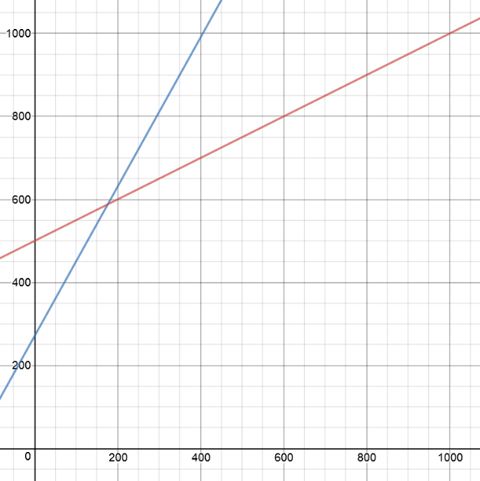
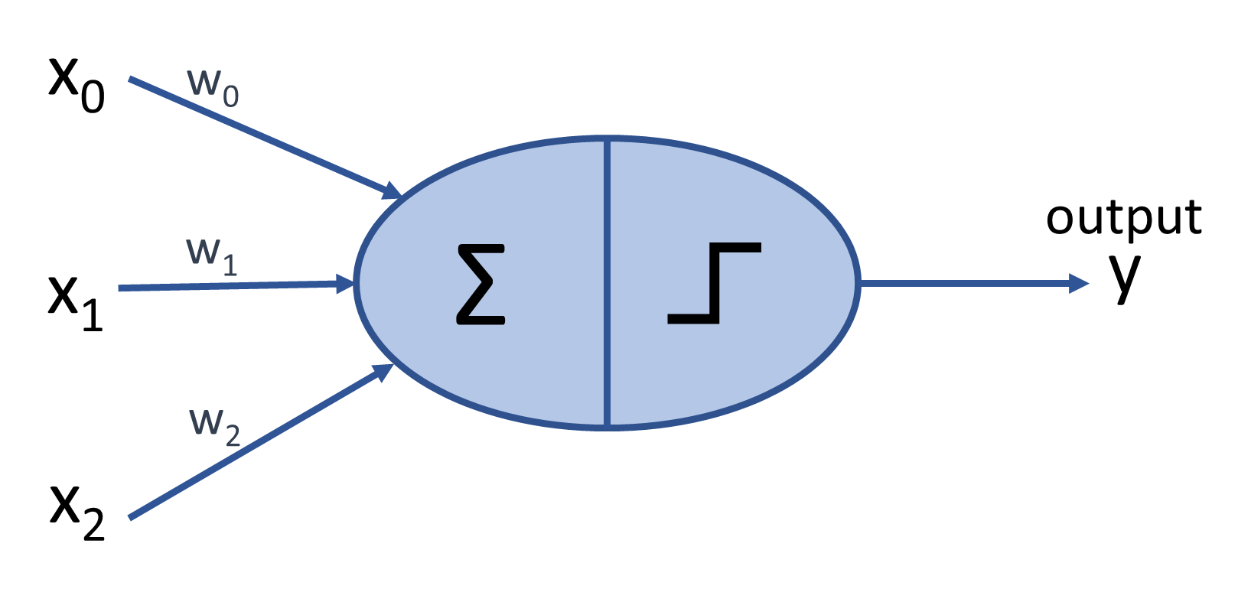
y = 0.5x + 500
After 10 million training points:
w₀ = -28.5
w₁ = +16.0
w₂ = -4329.5
-28.5x + 16.0y -4329.5 = 0
y = (28.5/16.0)x + (4329.5/16.0)
y = 1.8x + 270.6
accuracy 85.7%

Slide 21
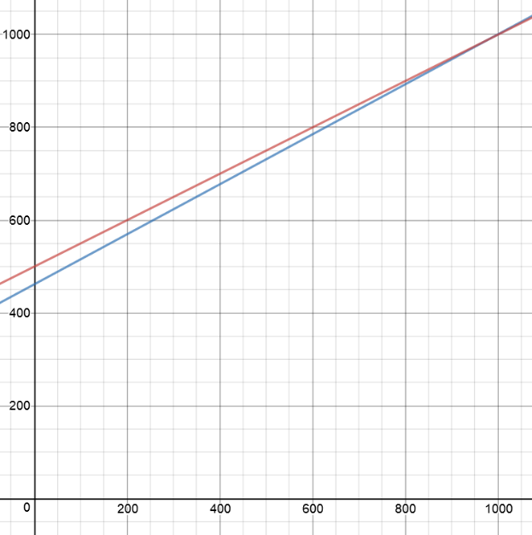
y = 0.5x + 500
After 100 million training points:
w₀ = -19.20
w₁ = +35.63
w₂ = -16457.09
-19.20x + 35.63y -16457.09 = 0
y = (19.20/35.63)x + (16457.09/35.63)
y = 0.5389x + 461.889
accuracy 97.7%
Normalization
Notes:
Bonus question: why does this model take so long to converge? How can this be fixed? (Answers: normalize inputs or increase ‘default’ bias to 1000)

Slide 22
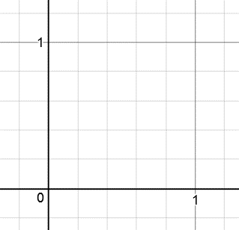
2nd input –
y-coordinate
TRUE when 1st AND
2nd inputs are
both = 1
FALSE when 1st AND
2nd inputs are not
both = 1
1st input –
x-coordinate
Notes:
Question: are we going to need bias? (Answer: yes)

Slide 23
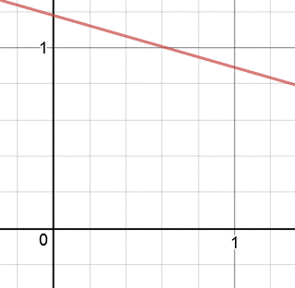
y = -.28769x + 1.1785
accuracy 100%
After 1000 training points:
w₀ = +0.01183
w₁ = +0.04112
w₂ = -0.04846
.01183x + .04112y -.04846 = 0

Slide 24
2nd input –
y-coordinate
TRUE when 1st OR
2nd inputs are = 1
FALSE when neither
1st OR 2nd inputs
are = 1
1st input –
x-coordinate
Notes:
Question: are we going to need bias? (Answer: yes)

Slide 25
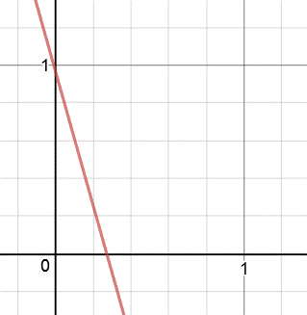
y = -3.5557x + .9651
accuracy 100%
After 1000 training points:
w₀ = +0.72241
w₁ = +0.20317
w₂ = -0.19608
.72241x + .20317y -.19608 = 0
Notes:
Note: that line is cutting it really, really close to (0,1). Neural networks, unlike SVMs, will not maximize the margins between the classes.

Slide 26
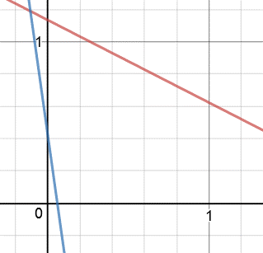
OR classification line:
y = -7.13775x + .42821
accuracy 100%
After 1,000,000 training points
AND classification line:
y = -.51216x + 1.13462
accuracy 100%
Notes:
Question: what is the smallest number of training points needed to achieve 100%? How can the learning rate affect this?

Slide 27
XOR is TRUE when
1st input ≠ 2nd input
XOR is FALSE when
1st input = 2nd input
2nd input –
y-coordinate
1st input –
x-coordinate
Notes:
Question: where are we going to draw the line? (Answer: this graph is “linearly inseparable.”)

Slide 28
hidden layer
output layer
input layer
x₀
w₁₀
x-coordinate
Or 1st operand
w₀₀
a₀
Σ
output
Σ
w₁₁
y
w₁₂
w₀₁
w₀₂
w₁₃
x₁
1
1
y-coordinate or
2nd operand
bias
bias

Slide 29
x-coordinate/
1st operand
hidden layer
1
bias
x₀
w₀₂
w₀₀
a₀
Σ
w₁₀
w₂₀
Σ
output
y
w₂₁
Σ
w₀₁
w₁₃
a₁
w₂₂
x₁
w₁₁
1
w₁₂
y-coordinate/
2nd operand
1
bias
bias

Slide 30
x₁∩x̄₂
x₁ \ x₂ | 1 | 0
1 | 0 | 1
0 | 0 | 0
x₁ \ x₂ | 1 | 0
1 | 0 | 1
0 | 0 | 0
a₁∪a₂
a₁ \ a₂ | 1 | 0
1 | 1 | 1
0 | 1 | 0
x₁
Σ
a₁
Σ
output
y
Σ
w₁₃
a₂
x₁ \ x₂ | 1 | 0
1 | 0 | 1
0 | 1 | 0
x₁ \ x₂ | 1 | 0
1 | 0∪0 | 1∪0
0 | 1∪0 | 0∪0
x₂
x₁ \ x₂ | 1 | 0
1 | 0 | 0
0 | 1 | 0
x₁ \ x₂ | 1 | 0
1 | 0 | 0
0 | 1 | 0
x₁⨁x₂
x̄₁∩x₂

Slide 31
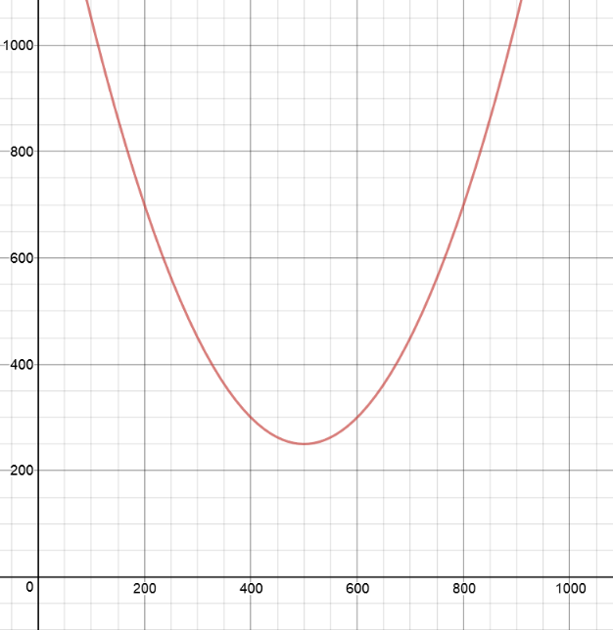
y = 0.005(x – 500)² + 250
2nd input –
y-coordinate
point to test
1st input –
x-coordinate

Slide 32
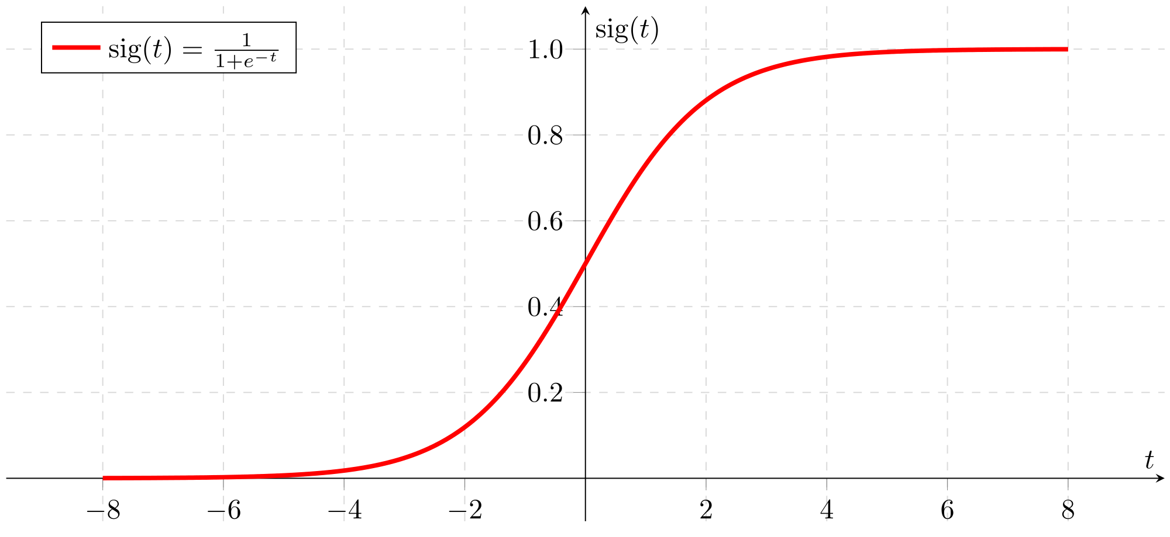

Slide 33
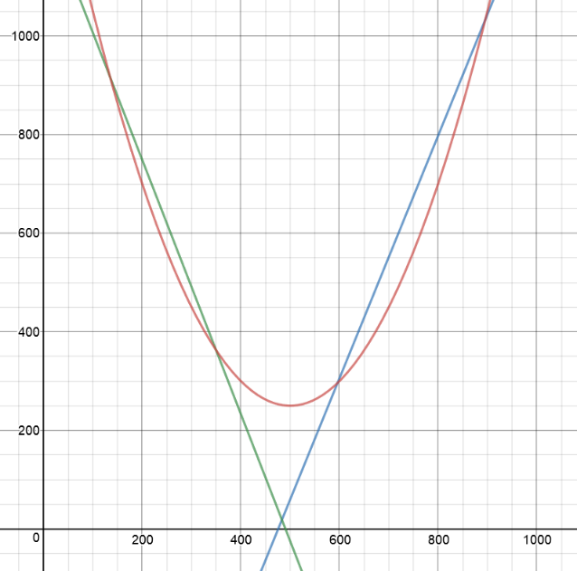
y = 0.005(x – 500)² + 250
y= -2.58x + 1264
y= 2.46x - 1170

